Slide 1



“九歌”——
基于深度学习的中国古典诗歌自动生成系统
清华大学 计算机系
人工智能研究院
自然语言处理与社会人文计算实验室
矣晓沅

Slide 2
任务背景及“九歌”作诗系统简介
基于显著性上下文机制的诗歌生成
基于工作记忆模型的诗歌生成
基于互信息的无监督风格诗歌生成

Slide 3
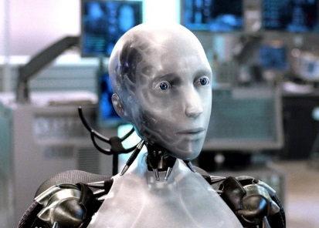
任务背景及“九歌”作诗系统简介
机器翻译
专家系统
对话系统
…
诗歌生成

Slide 4
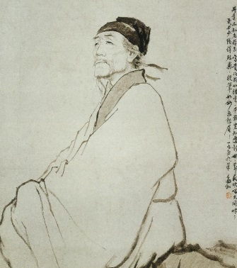

任务背景及“九歌”作诗系统简介
娱乐应用
诗词教育
文学研究
启发其他类型文本的生成
…

Slide 5
任务背景及“九歌”作诗系统简介
娱乐应用
诗词教育
自动分析、理解和生成文学性文本的理想切入点！
文学研究
启发其他类型文本的生成
…

Slide 6
任务背景及“九歌”作诗系统简介
ASPERA system (Gerv´as, 2001)
Haiku system (Wu et al., 2009).
……
第一阶段:
基于规则和模板的方法

Slide 7
任务背景及“九歌”作诗系统简介
ASPERA system (Gerv´as, 2001)
Haiku system (Wu et al., 2009).
……
第一阶段:
基于规则和模板的方法
Genetic Algorithm (Manurung, 2003; Levy, 2001)
Summarization Method (Yan et al., 2013)
SMT (Jiang and Zhou, 2008; He et al., 2012)
……
第二阶段:
统计机器学习方法

Slide 8
任务背景及“九歌”作诗系统简介
ASPERA system (Gerv´as, 2001)
Haiku system (Wu et al., 2009).
……
第一阶段:
基于规则和模板的方法
Genetic Algorithm (Manurung, 2003; Levy, 2001)
Summarization Method (Yan et al., 2013)
SMT (Jiang and Zhou, 2008; He et al., 2012)
……
第二阶段:
统计机器学习方法
RNNPG (Zhang and Lapata, 2014)
Polish (Yan, 2016)
Planning (Wang et al., 2016)
……
第三阶段:
神经网络方法

Slide 9

任务背景及“九歌”作诗系统简介
九歌是清华大学自然语言处理与社会人文计算实验室研发的自动诗歌生成系统。九歌研究团队由孙茂松教授带领。
系统采用最新的深度学习技术，结合多个为诗歌生成专门设计的不同模型，基于超过30万首的诗歌进行训练学习。九歌系统能够产生集句诗、近体诗、藏头诗、宋词等不同体裁的诗歌。该系统在生成诗歌的质量上有显著提升。作为一款融合现代技术和中国古典文化的有趣应用，九歌在推动自然语言处理技术发展，弘扬中华优秀传统文化等方面都有所帮助。

Slide 10
任务背景及“九歌”作诗系统简介
绝句生成。系统根据用户输入的一个关键词生成五言或七言绝句。
藏头绝句生成。用户给定1~4个藏头字，用户生成对应的五言或七言藏头绝句。
风格绝句生成。用户给定一个关键词，系统生成指定风格(如边塞、闺怨、山水田园等)的绝句。
集句诗生成。用户给定一句首句，系统自动计算匹配剩余诗句，形成一首集句诗。
宋词生成。根据用户输入的多个关键词，生成指定词牌的宋词，已支持词牌超过20个。

Slide 11
任务背景及“九歌”作诗系统简介
2017年4月，九歌测试版上线；
2017年8月, 九歌参加央视一套黄金时间大型科学挑战类节目《机智过人》, 与三位当代优秀诗人同台竞技，比拼诗词创作能力；当期节目网络播放量达约1000万次；
2017年9月10日，九歌正式版上线；
2017年9月, 九歌受邀参加首届中国北京国际语言文化博览会；
2017年11月, 九歌受邀参加《机智过人》人工智能年度盛典, 与著名演员张凯丽同台表演小品；
2017年12月, 九歌受邀在第七届吴文俊人工智能科学技术奖颁奖晚会进行作诗展示；
2017年12月, 九歌参加央视三套“收获2017”节目录制；
2018年5月， 九歌受邀参加央视“五月的鲜花”五四青年晚会录制；
九歌获全国计算语言学学术会议(CCL) 2017 最佳系统展示奖；
自2017年9月上线至今, 九歌累计访问量达到100万次。

Slide 12
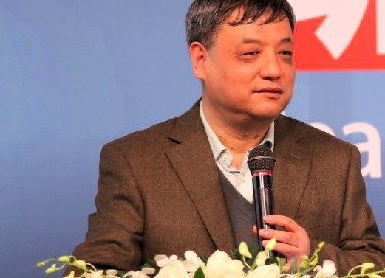


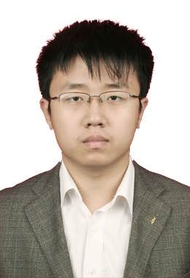
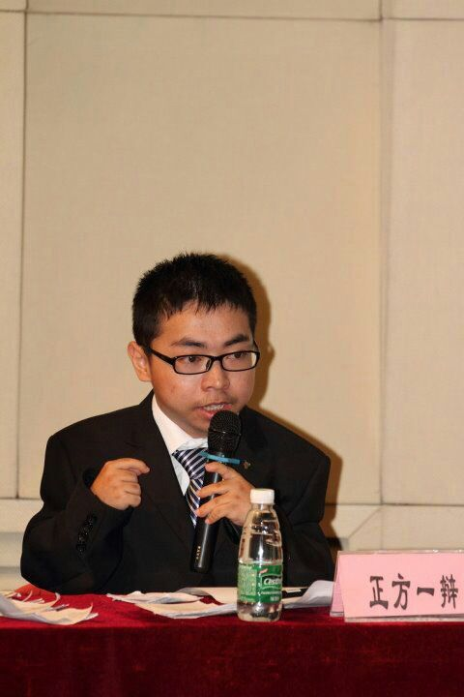
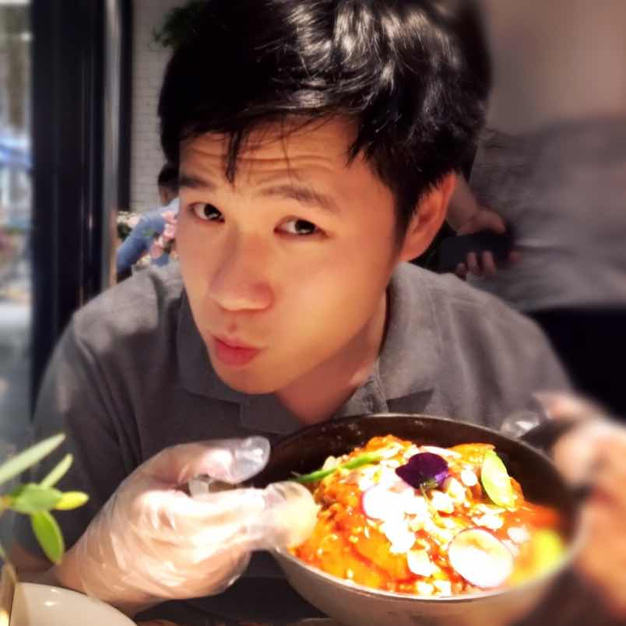
任务背景及“九歌”作诗系统简介
导师：
孙茂松教授
杨成
2014 级博士生
陈慧敏
2015级博士生
矣晓沅 2016级硕士生
梁健楠 2016级硕士生
郭志芃 2017级硕士生
参与系统开发的本科生：李文浩、杨宗瀚、魏钧宇

Slide 13

任务背景及“九歌”作诗系统简介
https://jiuge.thunlp.cn

Slide 14
基于显著性上下文机制的诗歌生成
Chinese Poetry Generation with a Salient-Clue Mechanism
Xiaoyuan Yi, Ruoyu Li, Maosong Sun
In CoNLL 2018

Slide 15
基于显著性上下文机制的诗歌生成
Innovation (Zhang et al., 2017)
Rhythmic Constraints (Ghazvininejad et al., 2016)
Keywords Insertion (Wang et al., 2016)
…

Slide 16
基于显著性上下文机制的诗歌生成
Innovation (Zhang et al., 2017)
Rhythmic Constraints (Ghazvininejad et al., 2016)
Keywords Insertion (Wang et al., 2016)
…
？
Context Coherence

Slide 17
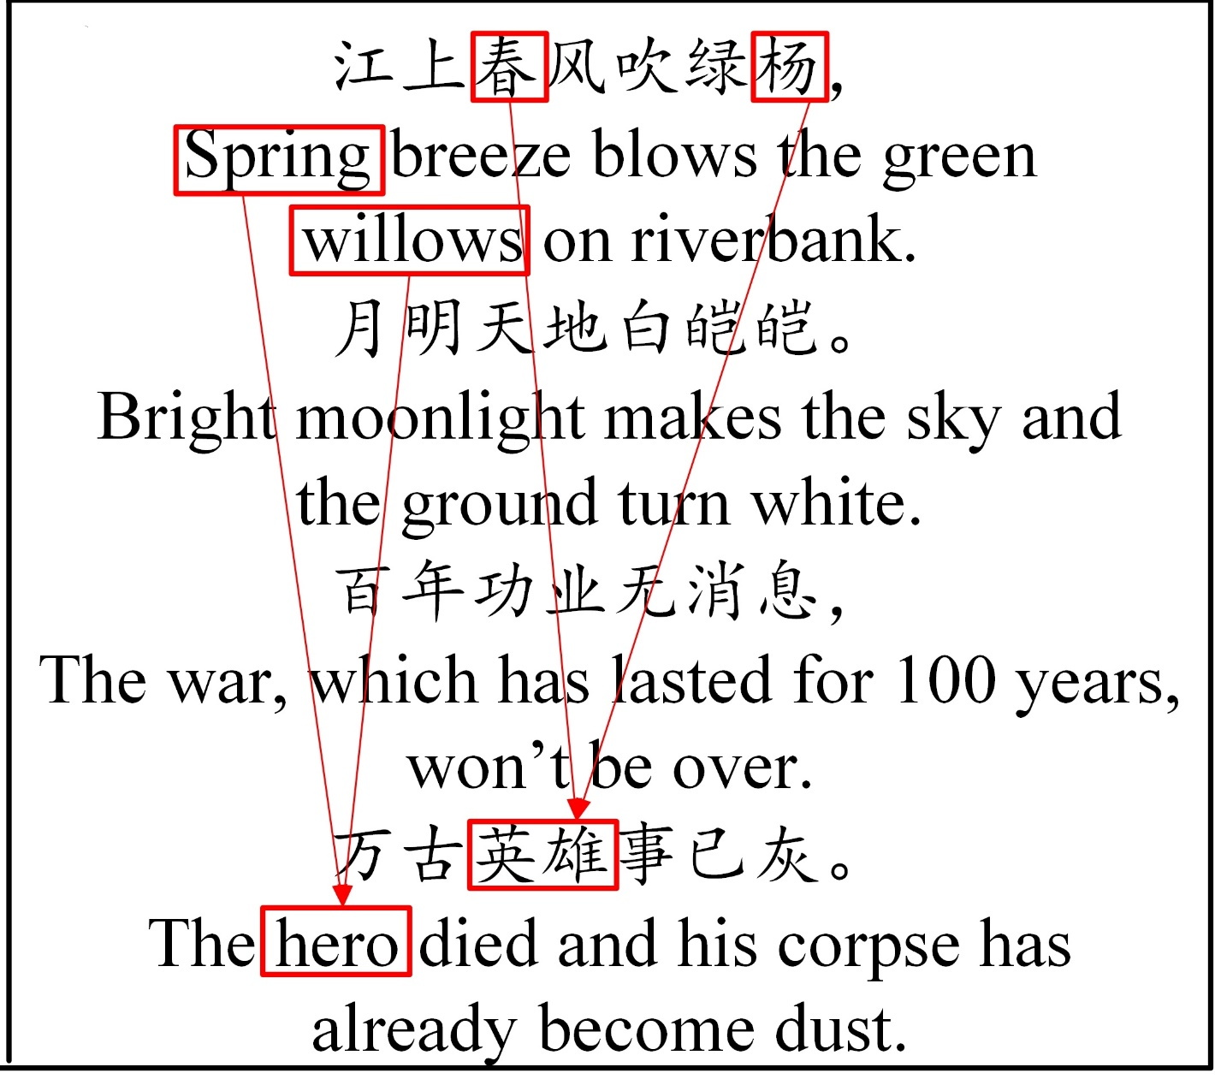
基于显著性上下文机制的诗歌生成
A poem generated by (Yan, 2016). The input keyword is chun feng (spring breeze). Red boxes and arrows show the inconsistency.

Slide 18
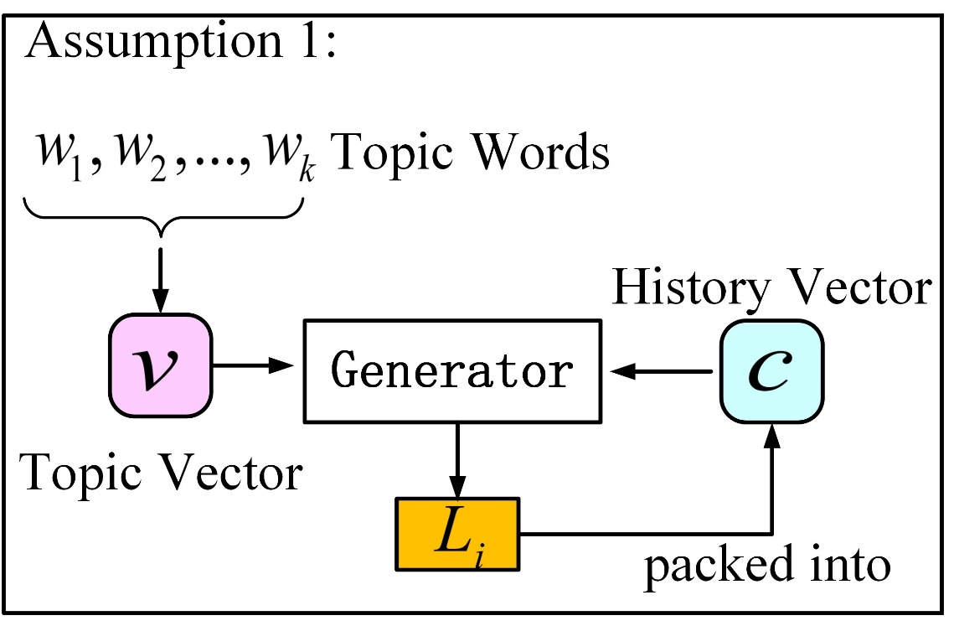
基于显著性上下文机制的诗歌生成
(1) Single history vector (Zhang and Lapata 2014; Yan,2016)
Insufficient capacity for maintaining the full history.
Informative words and noises are mixed (e.g., stop words).
Indiscriminate and inefficient use of the context.
A graphical illustration of assumption 1.
Packing Full Context (PFC)

Slide 19
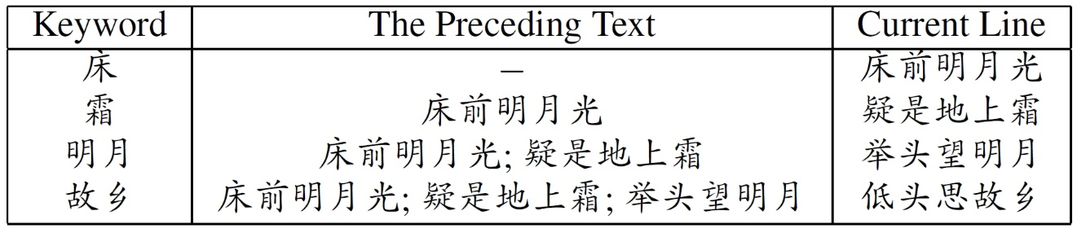
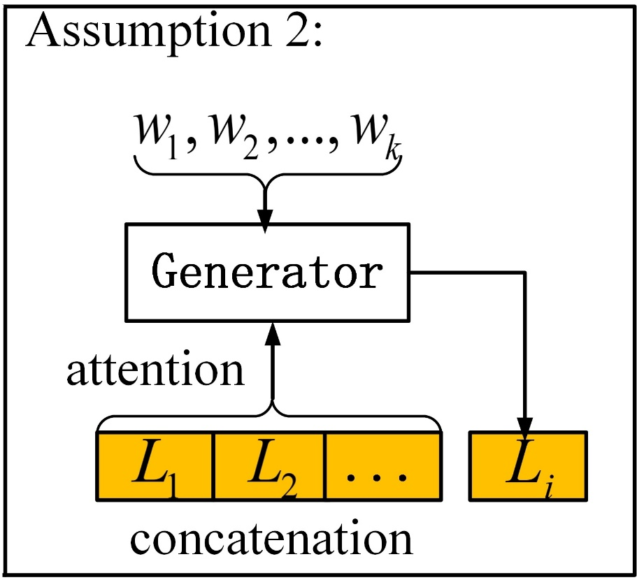
基于显著性上下文机制的诗歌生成
(2) The ability of exploring unlimited history. (Wang et al., 2016; Zhang et al., 2017)
Training triples extracted from a quatrain in (Wang et al., 2016)
Too long input/output sequences
The performance of seq2seq model degrades, even with an attention mechanism.
A graphical illustration of assumption 2.
N Lines to one line (nLto1L)

Slide 20
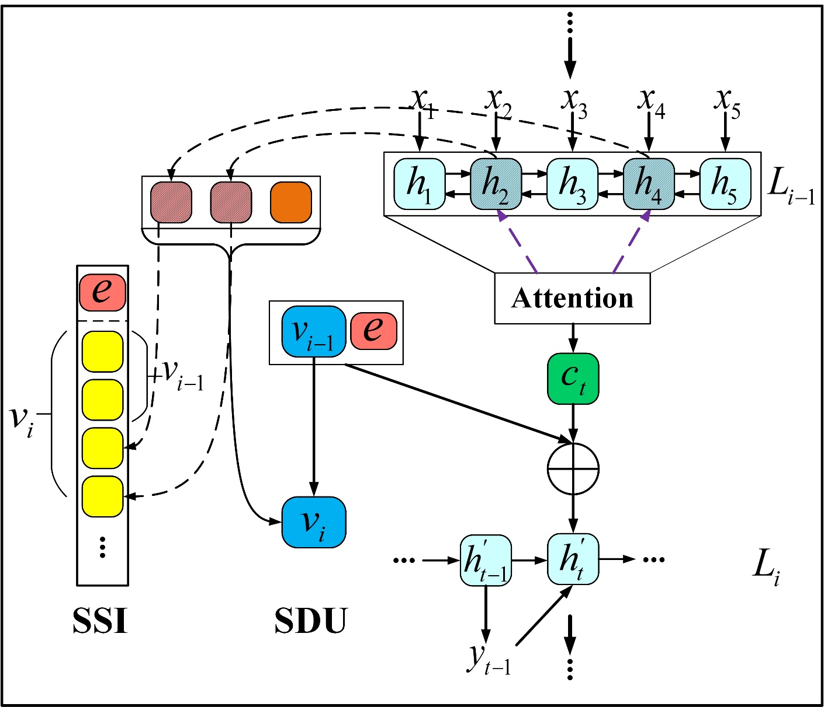
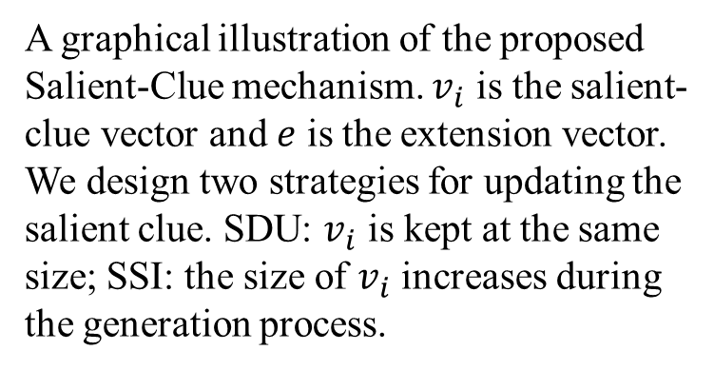
基于显著性上下文机制的诗歌生成
Design Philosophy: ignore the uninformative parts (e.g., stop words) and use some salient characters in context to represent the full context and form a salient clue, which is used to guide the generation process.
1. For each generated line: selects salient and informative characters to form the salient-clue.
2. When generating each line: utilizes the salient-clue.
A graphical illustration of the proposed Salient-Clue mechanism. $v_{i}$ is the salient-clue vector and $e$ is the extension vector. We design two strategies for updating the salient clue. SDU: $v_{i}$ is kept at the same size; SSI: the size of $v_{i}$ increases during the generation process.

Slide 21
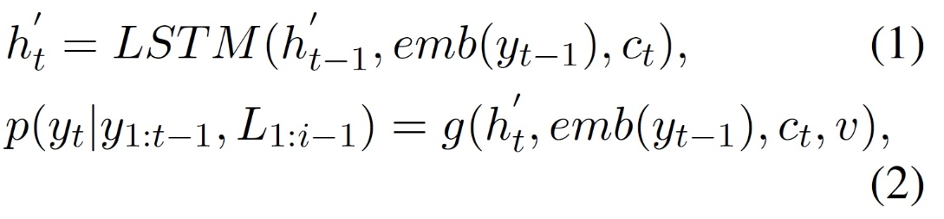
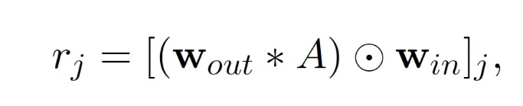
基于显著性上下文机制的诗歌生成
Basic framework: Bidirectional LSTM Encoder-Decoder with attention mechanism (Bahdanau et al., 2015)
A graphical illustration of the proposed Salient-Clue mechanism. $v_{i}$ is the salient-clue vector and $e$ is the extension vector. We design two strategies for updating the salient clue. SDU: $v_{i}$ is kept at the same size; SSI: the size of $v_{i}$ increases during the generation process.
(3)
the attention alignment matrix in the attention mechanism

Slide 22
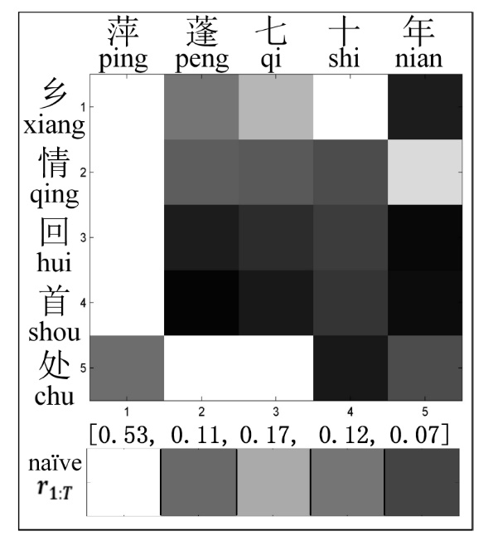
基于显著性上下文机制的诗歌生成
A graphical illustration of the proposed Salient-Clue mechanism. $v_{i}$ is the salient-clue vector and $e$ is the extension vector. We design two strategies for updating the salient clue. SDU: $v_{i}$ is kept at the same size; SSI: the size of $v_{i}$ increases during the generation process.
An example of calculating the saliency score of each character (in the x-axis) from the attention matrix (0:black, 1:white), in the naive Salient-Clue. The scores are normalized to interval [0,1] here.

Slide 23
基于显著性上下文机制的诗歌生成
A graphical illustration of the proposed Salient-Clue mechanism. $v_{i}$ is the salient-clue vector and $e$ is the extension vector. We design two strategies for updating the salient clue. SDU: $v_{i}$ is kept at the same size; SSI: the size of $v_{i}$ increases during the generation process.
An example of calculating the saliency score of each character (in the x-axis) from the attention matrix (0:black, 1:white), in the naive Salient-Clue. The scores are normalized to interval [0,1] here.

Slide 24
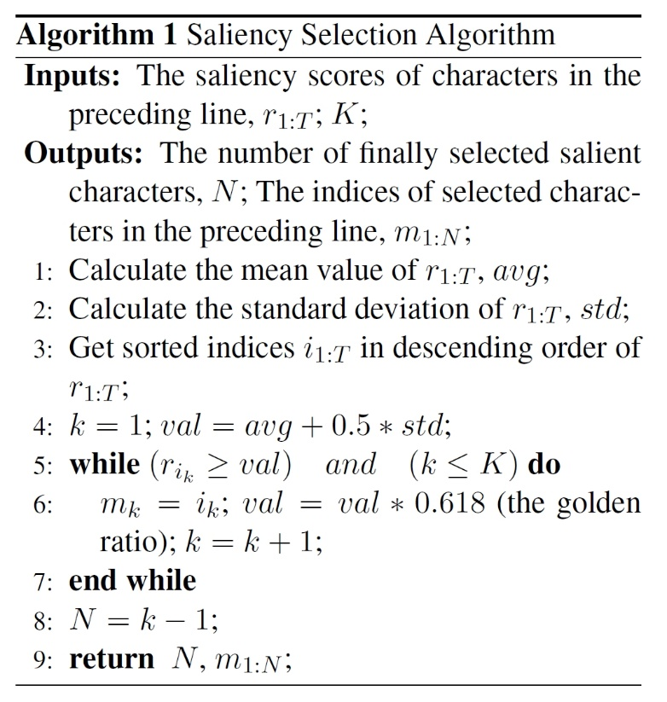
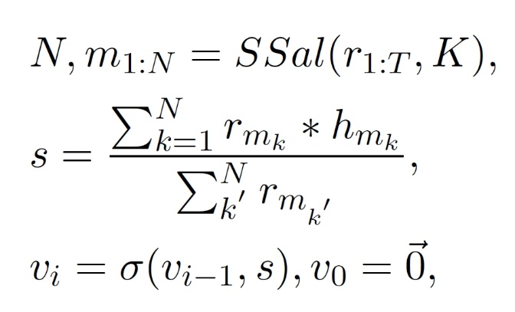
基于显著性上下文机制的诗歌生成
A graphical illustration of the proposed Salient-Clue mechanism. $v_{i}$ is the salient-clue vector and $e$ is the extension vector. We design two strategies for updating the salient clue. SDU: $v_{i}$ is kept at the same size; SSI: the size of $v_{i}$ increases during the generation process.
(4)

Slide 25
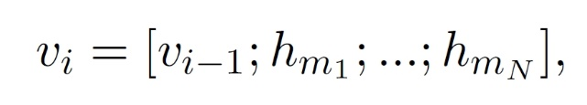
基于显著性上下文机制的诗歌生成
Saliency Dynamic Update (SDU) V.S. PFC
(5)
(6)
A graphical illustration of the proposed Salient-Clue mechanism. $v_{i}$ is the salient-clue vector and $e$ is the extension vector. We design two strategies for updating the salient clue. SDU: $v_{i}$ is kept at the same size; SSI: the size of $v_{i}$ increases during the generation process.
Saliency Sensitive Identity (SSI) V.S nLto1L
(7)

Slide 26
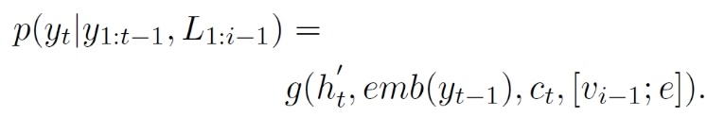
基于显著性上下文机制的诗歌生成
Extensions of Salient-Clue
(8)
Intent Salient-Clue
Feed the keyword into Encoder, then vector e is calculated by a non-linear transformation of the average of their hidden states.
A graphical illustration of the proposed Salient-Clue mechanism. $v_{i}$ is the salient-clue vector and $e$ is the extension vector. We design two strategies for updating the salient clue. SDU: $v_{i}$ is kept at the same size; SSI: the size of $v_{i}$ increases during the generation process.
Style Salient-Clue
Simply use a style embedding as the vector e. Use LDA to train the whole corpus. For three main styles, Pastoral, Battlefield and Romantic, find the corresponding topics manually. Then all poems are labeled by LDA inference.

Slide 27
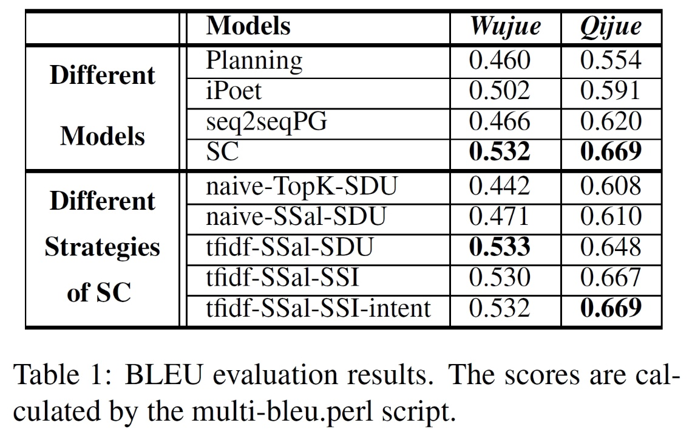
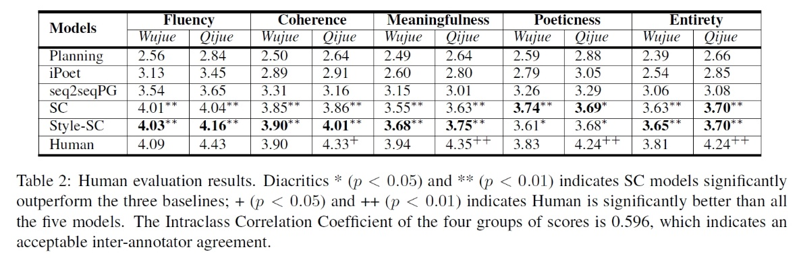
基于显著性上下文机制的诗歌生成
Experimental Results

Slide 28
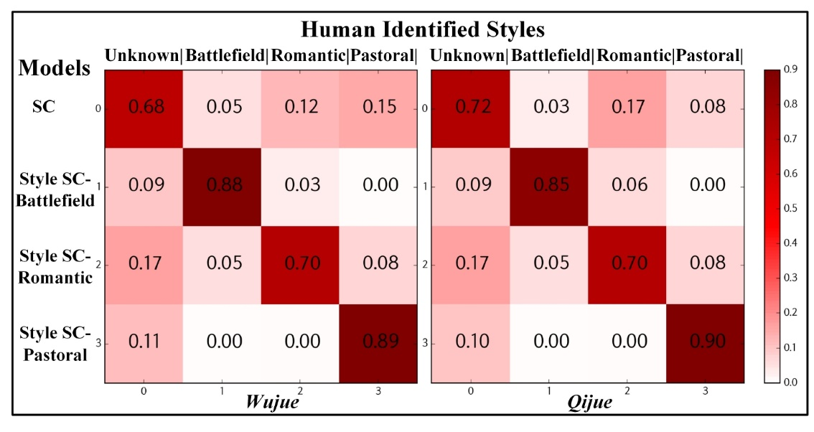
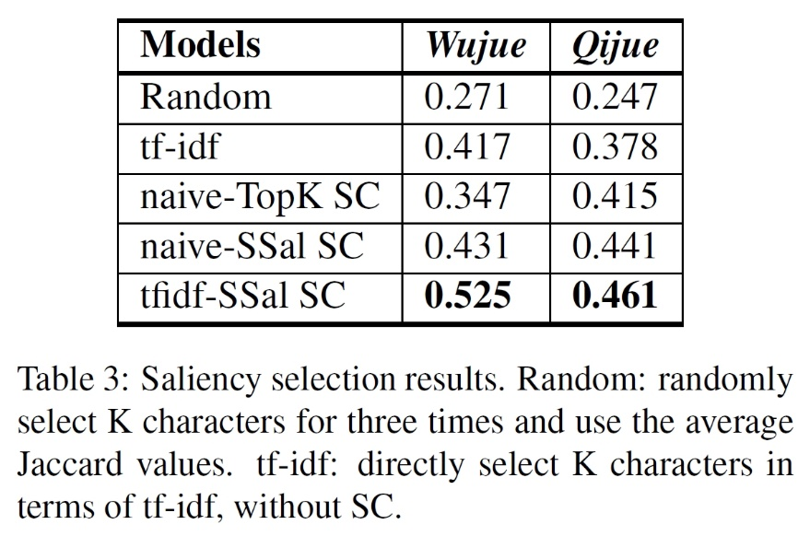
基于显著性上下文机制的诗歌生成
Style control evaluation results. The values are ratios that generated poems are identified as different styles by human experts.

Slide 29
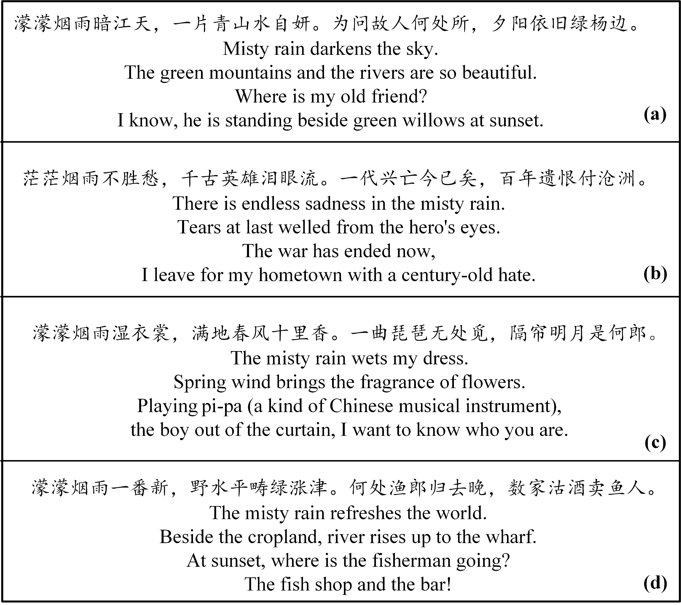
基于显著性上下文机制的诗歌生成
Four Qijues generated with the same keyword “烟雨” (misty rain) as input. (a) non-style by SC. (b) Battlefield style by Style-SC. (c) Romantic style by Style-SC. (d) Pastoral style by Style-SC.

Slide 30
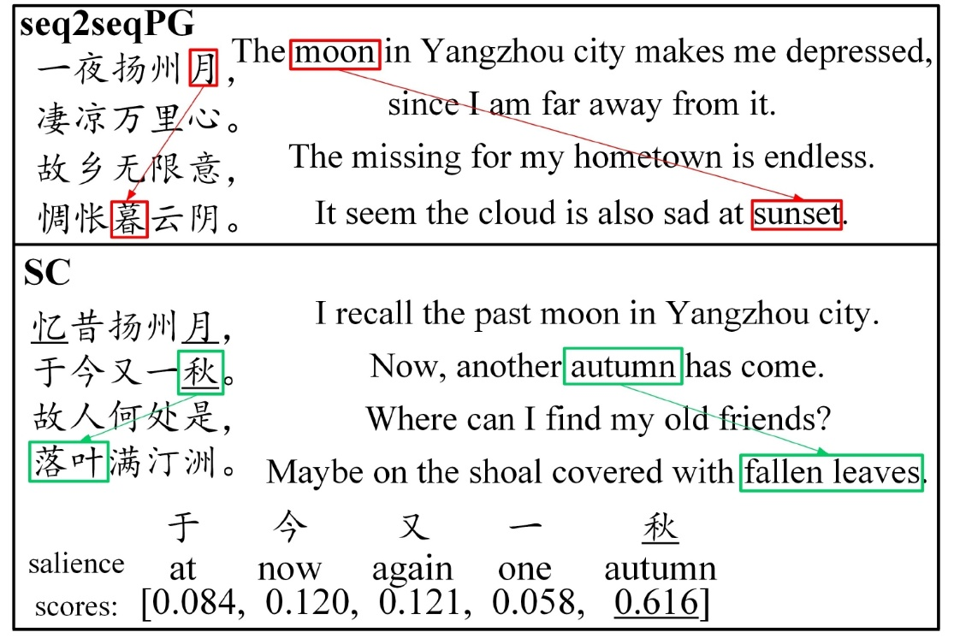
基于显著性上下文机制的诗歌生成
Case Study
Two Wujues generated with the same input. Green boxes and arrows show consistencies, and the red ones show inconsistencies. Automatically selected charcters by SC are underlined.

Slide 31
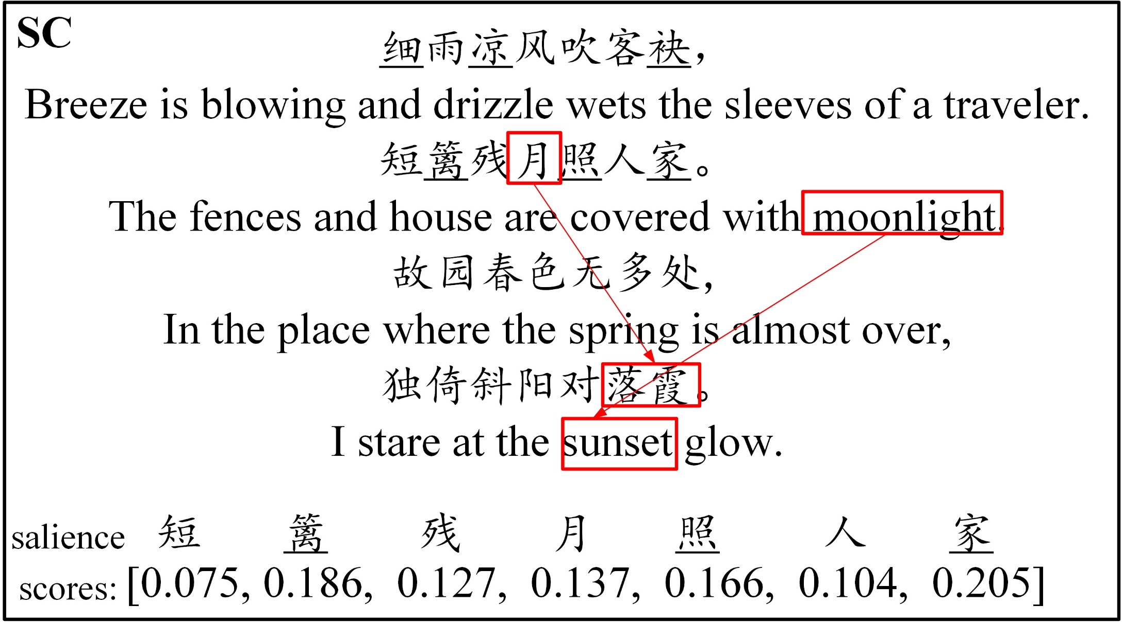
基于显著性上下文机制的诗歌生成
Weakness
1. Inflexible selection method
A negative example. A Qijue generated by our SC model. Red box and arrow show the inconsistency.

Slide 32
基于显著性上下文机制的诗歌生成
Weakness
1. Inflexible selection method
2. Supervised learning for style transfer
Expensive labeled data
Losing some fluency and Poeticness
A negative example. A Qijue generated by our SC model. Red box and arrow show the inconsistency.

Slide 33
基于工作记忆模型的诗歌生成
Chinese Poetry Generation with a Working Memory Model
Xiaoyuan Yi, Maosong Sun, Ruoyu Li, Zonghan Yang
In IJCAI 2018

Slide 34
Coherence in Psycholinguistics
基于工作记忆模型的诗歌生成
Coherence is achieved if the reader can connect the incoming sentence to the content in working memory and to the major messages and points of the text [Sanders et al., 2001].
The working memory is a system with a limited capacity that is responsible for holding information available for reasoning, decision-making and behavior [Priti and Miyake, 1999].

Slide 35
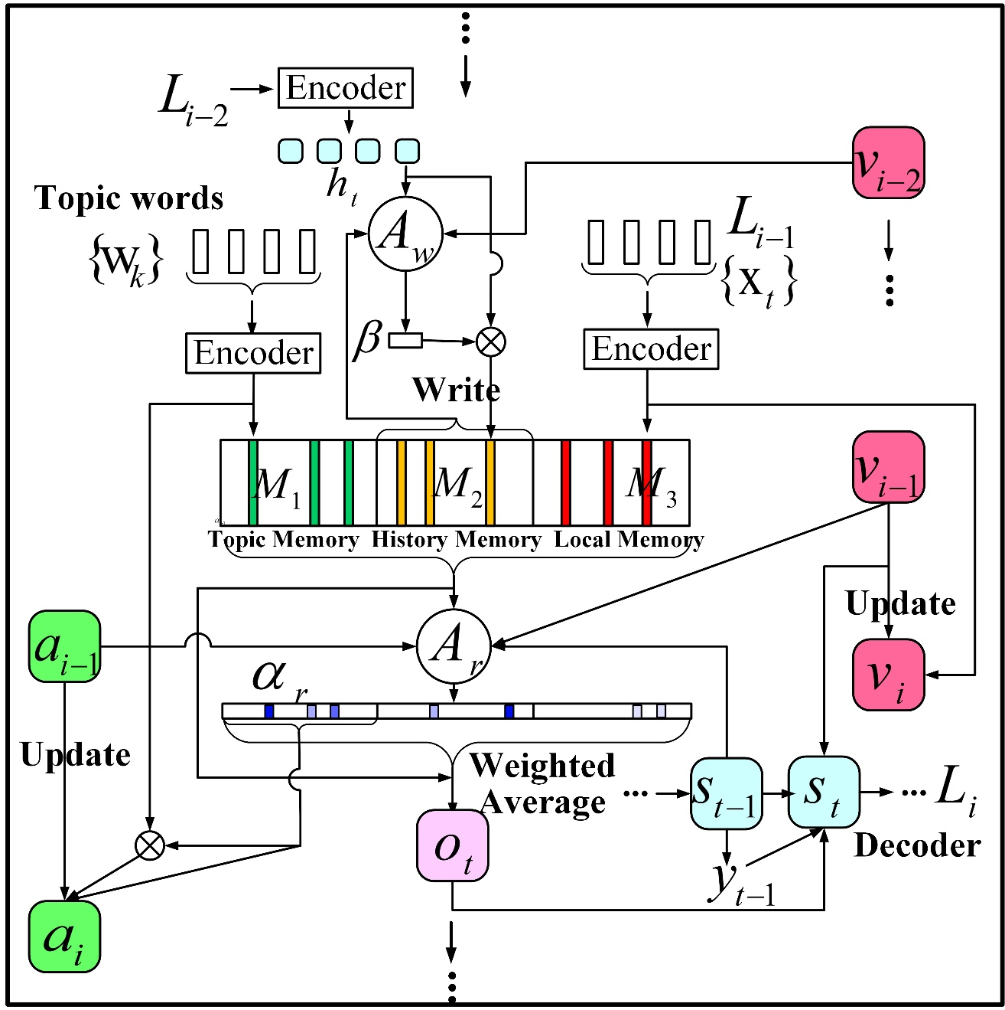

基于工作记忆模型的诗歌生成
Topic Memory $M_{1}$
Each topic word is maintained
in the topic memory explicitly
and independently.
Major messages and points of the text !
Flexible order and form of the topic expression!

Slide 36

基于工作记忆模型的诗歌生成
History Memory $M_{2}$
1. For each generated line: selects salient and informative characters to write into it.
2. When generating each line: reads most relevant from it.
Multiple, independent but limited memory slots→ enough capacity!
Always keep a coherent information flow in the history memory!

Slide 37
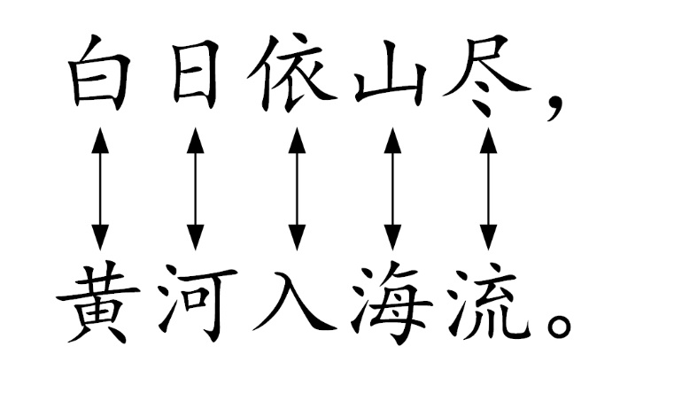
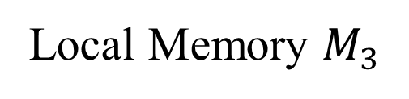
基于工作记忆模型的诗歌生成
Local Memory $M_{3}$
Save the previously generated line.
Strong semantic associations between two adjacent lines in Chinese poetry！
The local memory provides full
short-distance history.

Slide 38
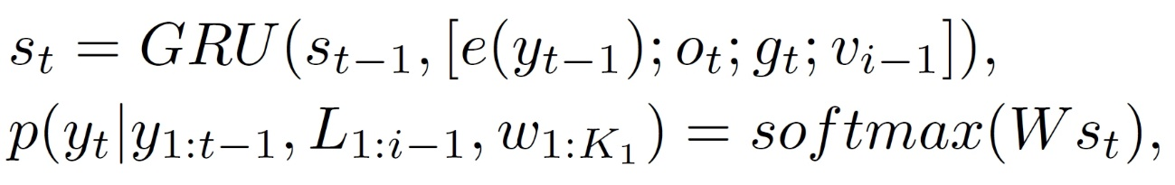
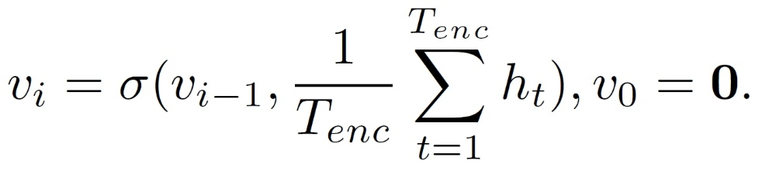
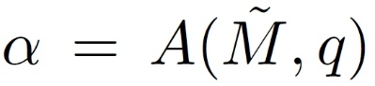
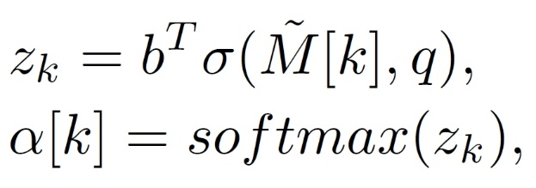
基于工作记忆模型的诗歌生成
Decoder:
Global trace vector:
Addressing function:

Slide 39
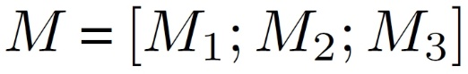
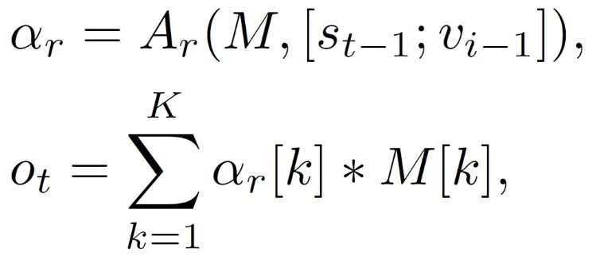
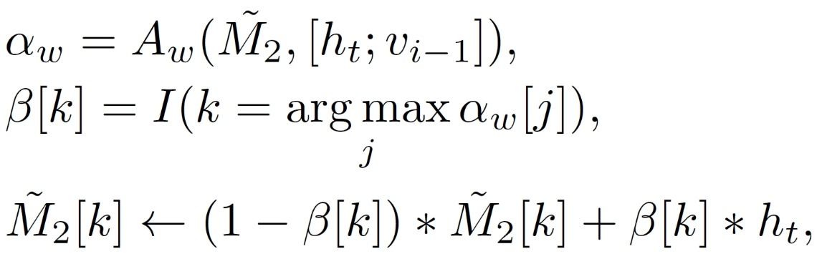
基于工作记忆模型的诗歌生成
Memory reading:
Jointly read the three memory modules!
Memory writing:

Slide 40
基于工作记忆模型的诗歌生成
Genre embedding
The genre embedding vector
The length of each line.
The phonological category of each character
Transparent to poetry genre!

Slide 41
基于工作记忆模型的诗歌生成
Topic Trace mechanism
Record the usage of topics in a more explicit way!
Maintain the content of used topics
Explicitly records the times of reading each topic
Improve topic expression ratio! (>70%)

Slide 42
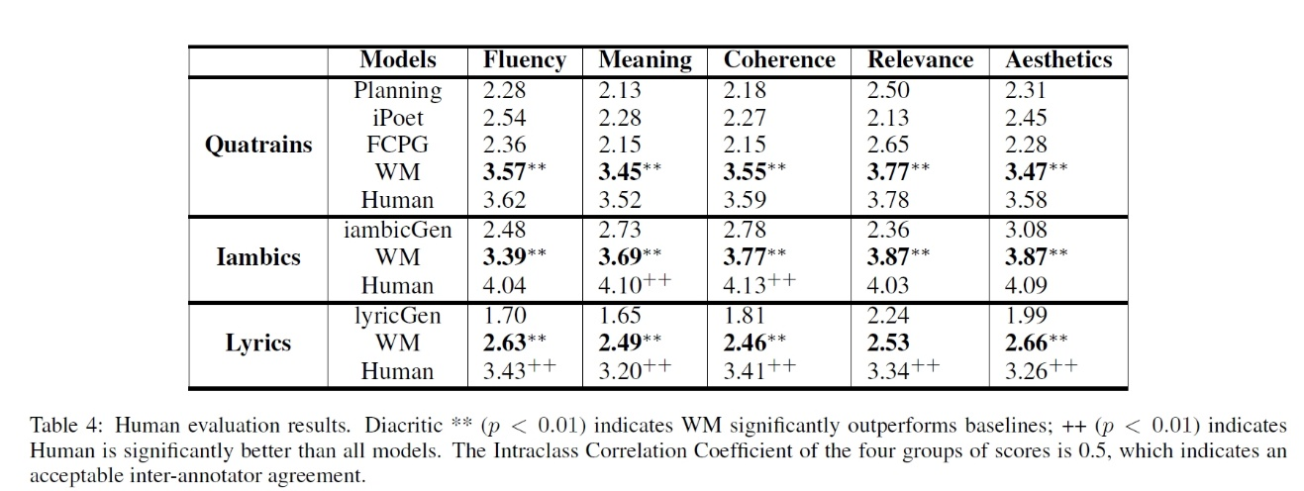
Experiments
基于工作记忆模型的诗歌生成

Slide 43
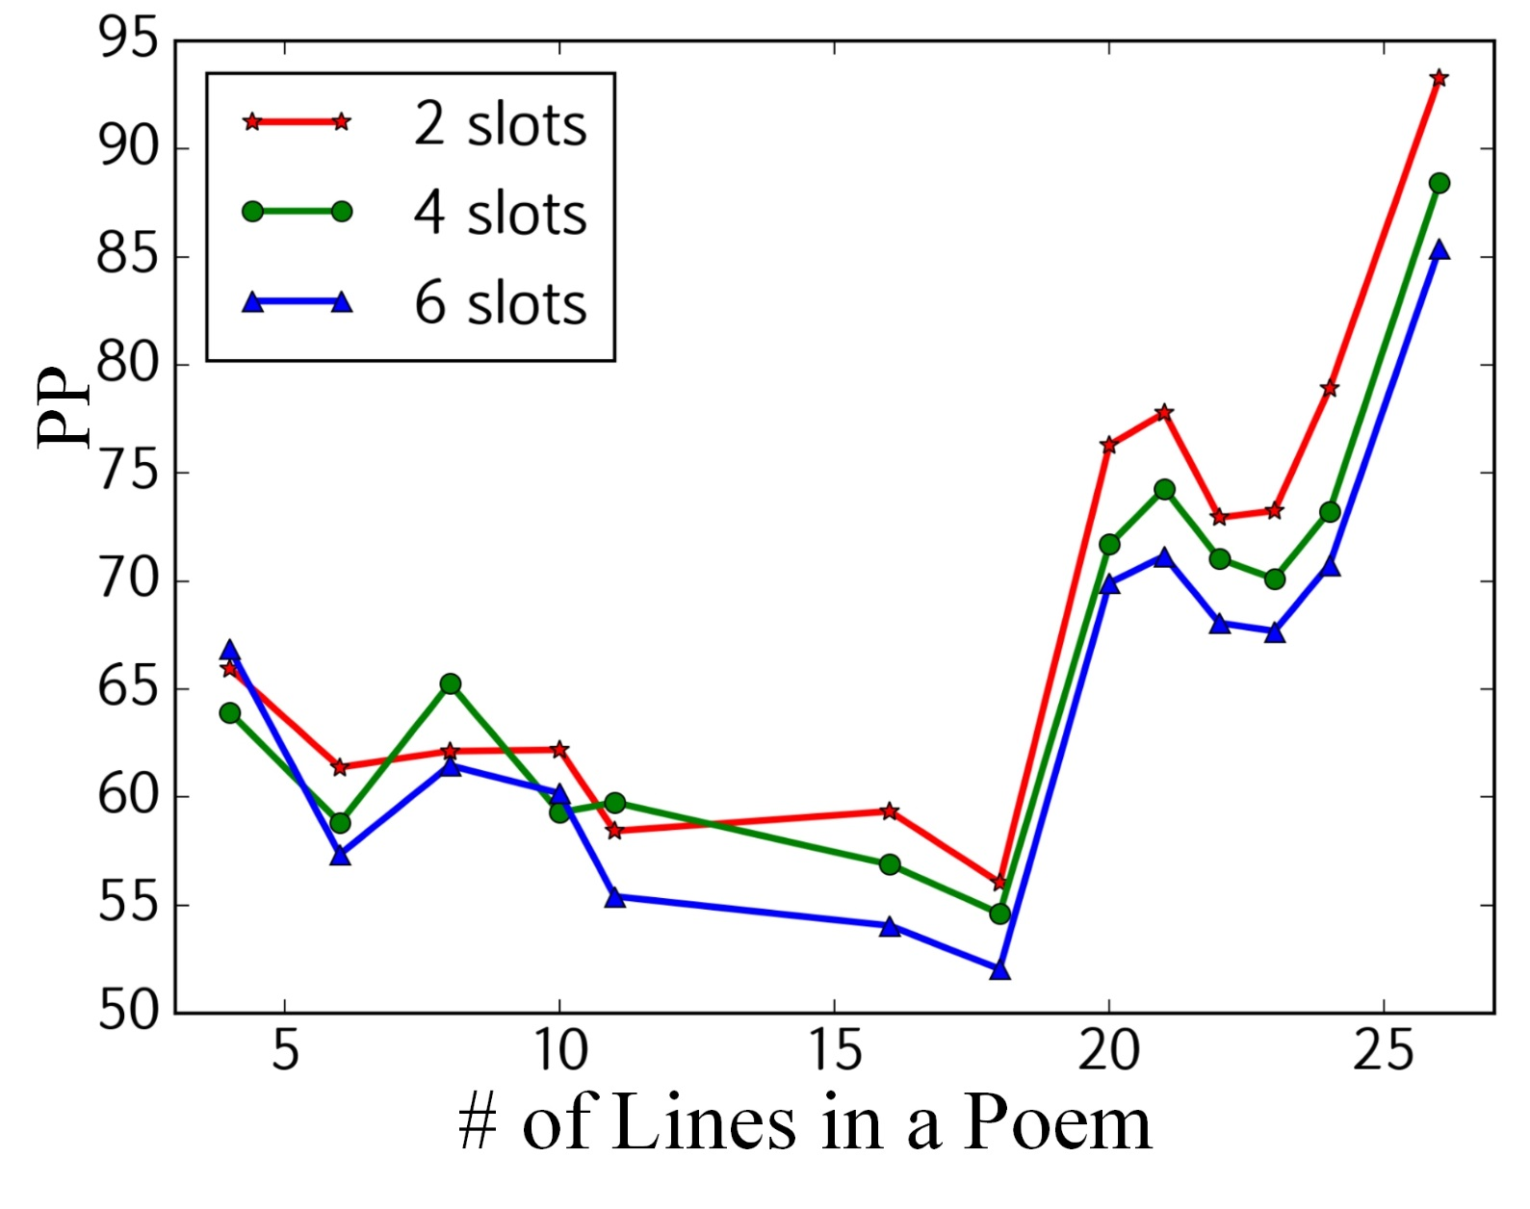
基于工作记忆模型的诗歌生成
On iambics, perplexity over different numbers of lines in a poem

Slide 44
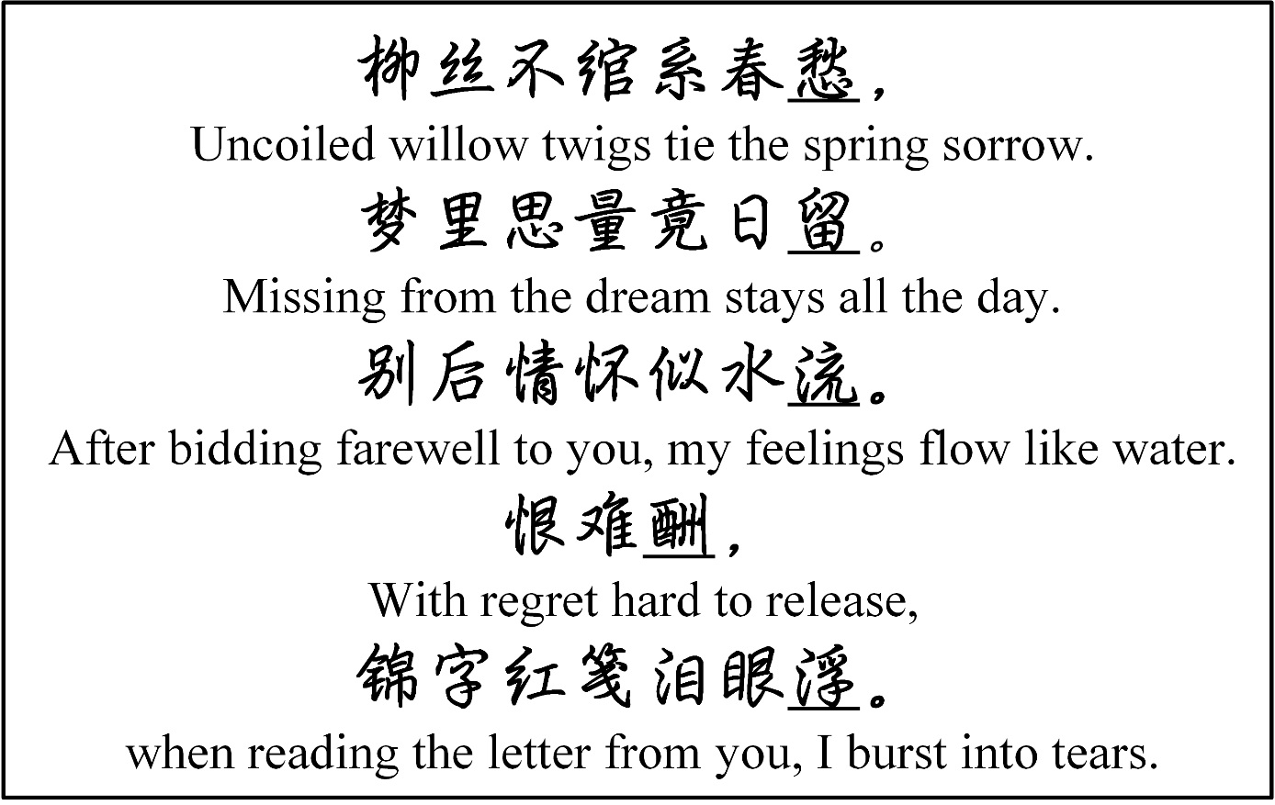

基于工作记忆模型的诗歌生成
Case Study
An iambic generated by our model, taking 柳 (willow) and 思君 (missing you) as input words.

Slide 45
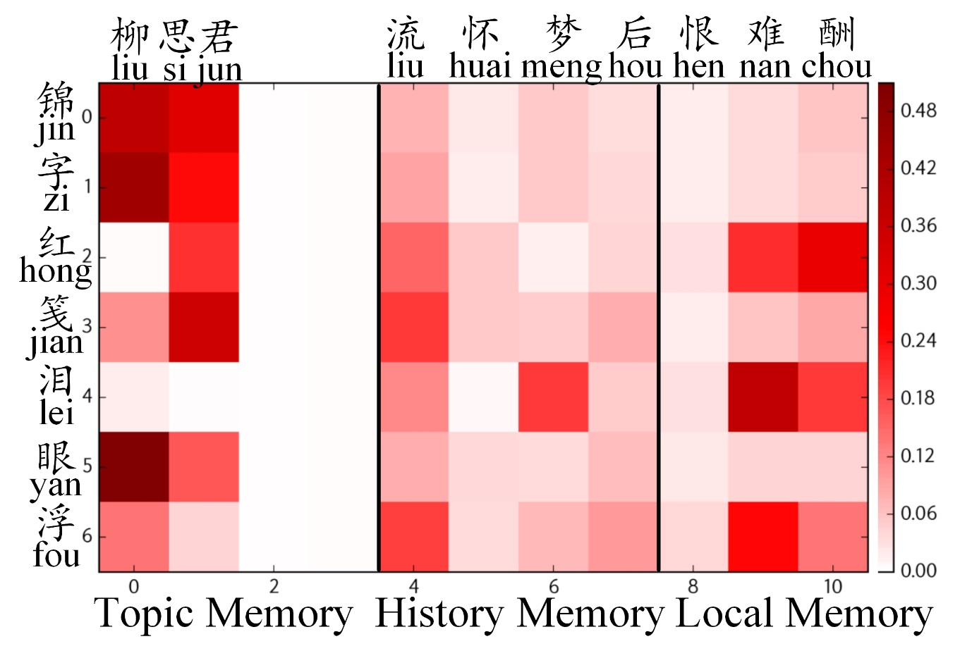



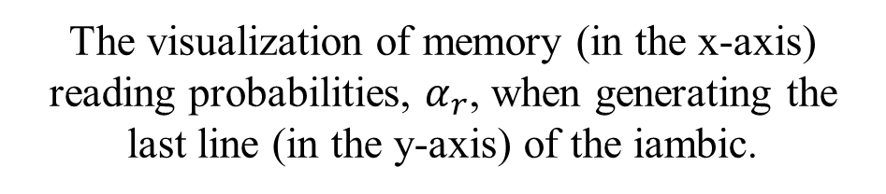
基于工作记忆模型的诗歌生成
Case Study
An iambic generated by our model, taking 柳 (willow) and 思君 (missing you) as input words.
The visualization of memory (in the x-axis) reading probabilities, $α_{r}$, when generating the last line (in the y-axis) of the iambic.

Slide 46
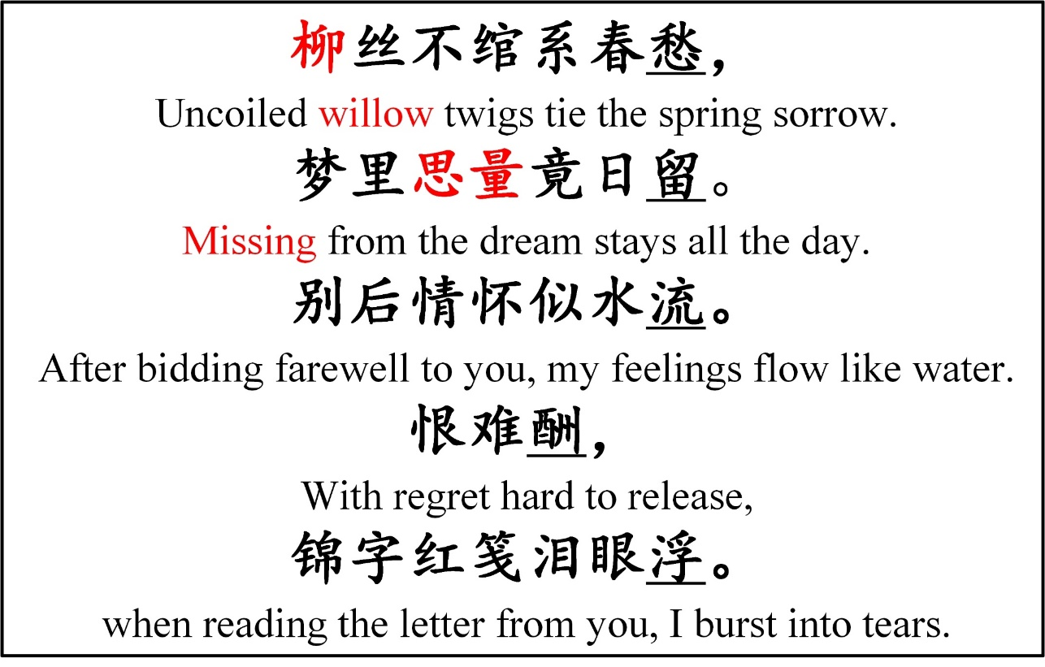
基于工作记忆模型的诗歌生成
An iambic generated by our model, taking liu (willow) and sijun (missing you) as input words.
flexible form!

Slide 47
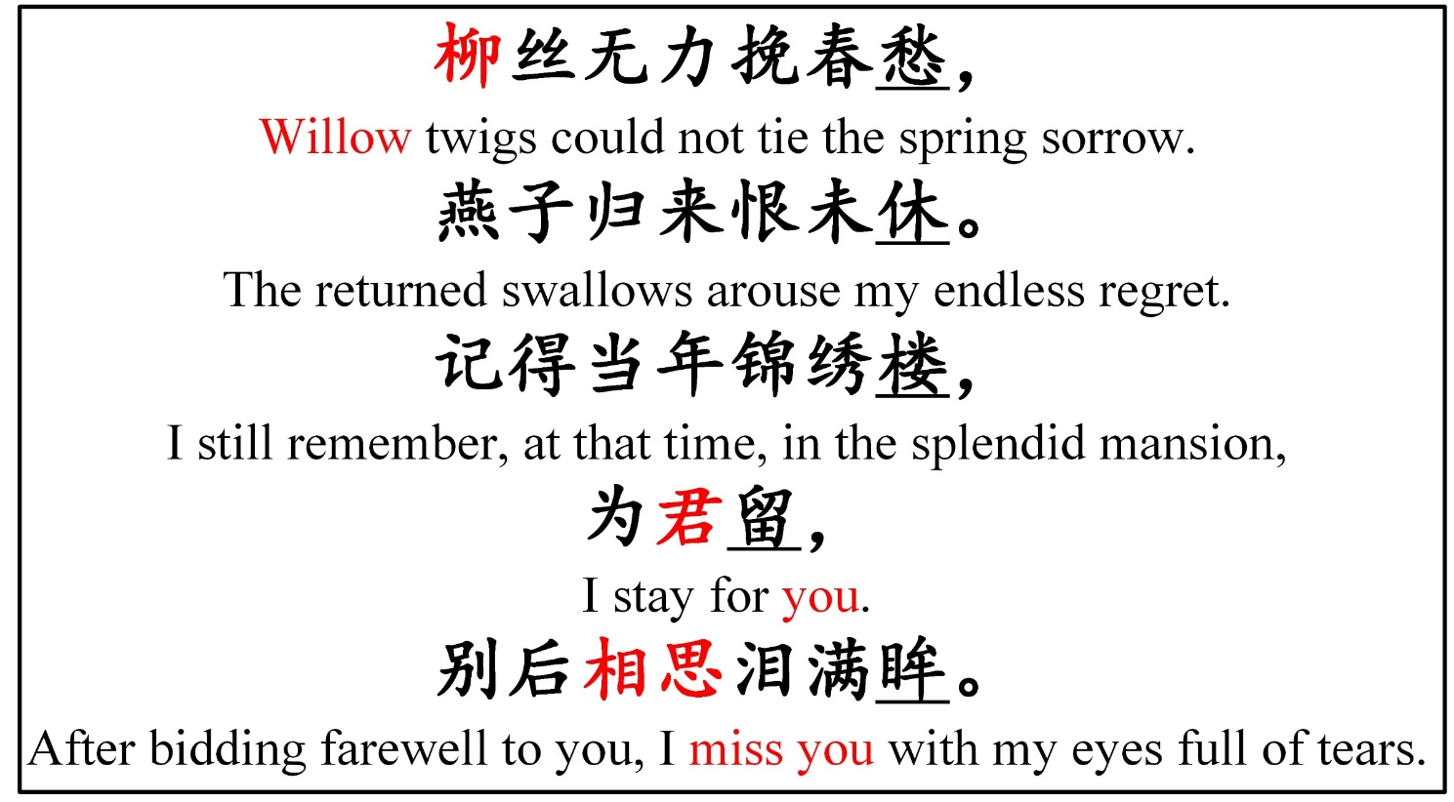
基于工作记忆模型的诗歌生成
An iambic generated by our model, taking liu (willow) and sijun (missing you) as input words.
Force the keyword, sijun (missing you) not to appear in the first three lines.
flexible form!
flexible order!

Slide 48
基于互信息的无监督风格诗歌生成
Stylistic Chinese Poetry Generation via Unsupervised Style
Disentanglement
Cheng Yang, Maosong Sun, Xiaoyuan Yi, Wenhao Li
In EMNLP 2018

Slide 49
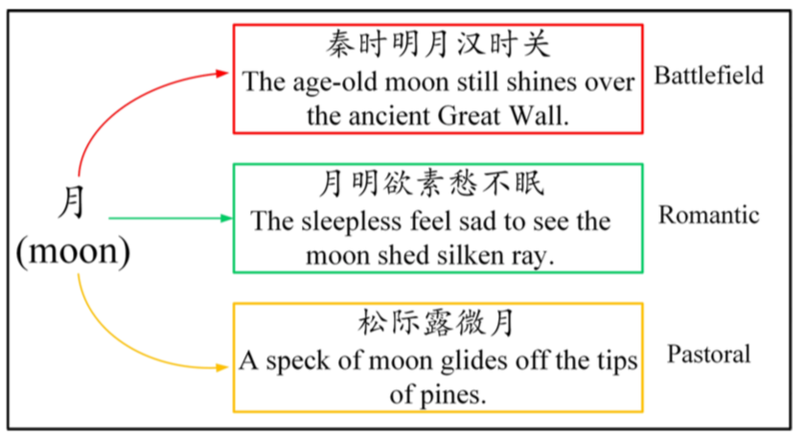
基于互信息的无监督风格诗歌生成
Motivation
An example of poems in diverse styles
under the same keyword.

Slide 50
基于互信息的无监督风格诗歌生成
Motivation
Our model should be able to generate multiple outputs given the same input.
The outputs should be diverse and different in style from each other.
The method should be unsupervised since there is no explicit label or topic labeling for poems in the corpus.
There should be no loss in other criteria, e.g, fluency.
An example of poems in diverse styles
under the same keyword.

Slide 51
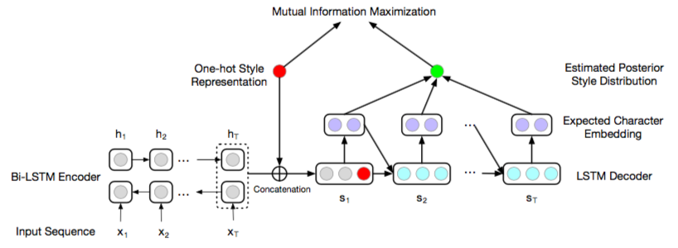
基于互信息的无监督风格诗歌生成
An overview of style disentanglement by mutual information maximization.

Slide 52
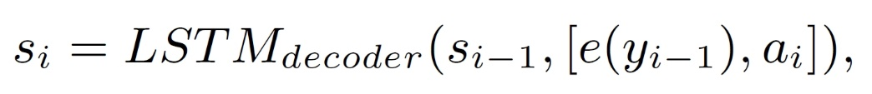
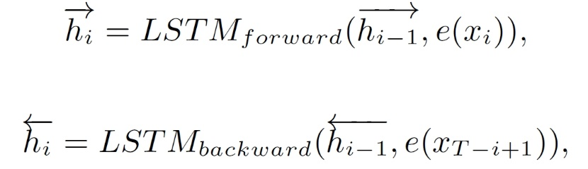
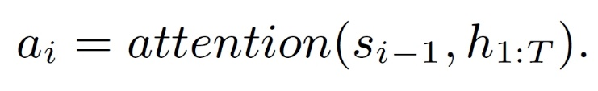
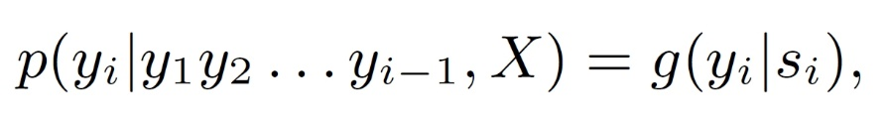
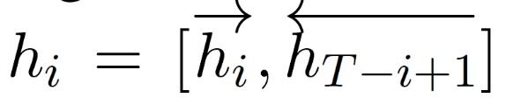

基于互信息的无监督风格诗歌生成
Basic Framework
Encoder
Decoder
$$s_{0}=h_{T}$$

Slide 53



基于互信息的无监督风格诗歌生成
Basic Framework
Decoder
$$s_{0}=h_{T}$$
Our model takes two arguments as input:
input sentence $s_{input}$ and
style id $k∈1,2,…,K$.
$$s_{0}={[onehot(k); h}_{T}]$$

Slide 54

基于互信息的无监督风格诗歌生成
Add a regularization term to force a strong dependency relationship between the input style id and generated sentence!
Given two random variables X and Y, the mutual information I(X,Y) measures “the amount of information” obtained about one random variable given another one.

Slide 55


基于互信息的无监督风格诗歌生成
Assume that the input style id is a uniformly distributed random variable $Sty$ and $\operatorname{Pr}\left(Sty\right)=\frac{1}{K}, k=1,2,…,K$
Maximize the mutual information between
the style distribution $\operatorname{Pr}\left(Sty\right)$ and the generated sentence distribution $\operatorname{Pr}\left(X;Y\right)$given input sentence X.

Slide 56

基于互信息的无监督风格诗歌生成

Slide 57


基于互信息的无监督风格诗歌生成
Variational Lower Bound

Slide 58
基于互信息的无监督风格诗歌生成
Variational Lower Bound

Slide 59

基于互信息的无监督风格诗歌生成
Maximize

Slide 60
基于互信息的无监督风格诗歌生成
Maximize
Problem: Impossible to integrate over all possible sequences.

Slide 61

基于互信息的无监督风格诗歌生成
Maximize
Problem: Impossible to integrate over all possible sequences.
Solution: We only generate an expected embedding sequence and suppose $Y|k;X$ has one hundred percent probability generating this one.

Slide 62

基于互信息的无监督风格诗歌生成
Expected Character Embedding (Kočciský et al., 2016)

Slide 63



基于互信息的无监督风格诗歌生成
Expected Character Embedding (Kočciský et al., 2016)
$$≈$$
$$=$$

Slide 64

基于互信息的无监督风格诗歌生成
Maximize

Slide 65
基于互信息的无监督风格诗歌生成
Maximize
style irrelevant generation likelihood, which computed by setting one-hot style representation to an all-zero vector.

Slide 66
基于互信息的无监督风格诗歌生成
Maximize
style irrelevant generation likelihood, which computed by setting one-hot style representation to an all-zero vector.
Ensures that the decoder can generate fluent and coherent outputs.

Slide 67
基于互信息的无监督风格诗歌生成
Maximize
style irrelevant generation likelihood, which computed by setting one-hot style representation to an all-zero vector.
Style regularization
Ensures that the decoder can generate fluent and coherent outputs.

Slide 68
基于互信息的无监督风格诗歌生成
Maximize
style irrelevant generation likelihood, which computed by setting one-hot style representation to an all-zero vector.
Style regularization
Guarantees the style-specific output has a strong dependency on the one-hot style representation input.
Ensures that the decoder can generate fluent and coherent outputs.

Slide 69
基于互信息的无监督风格诗歌生成
Maximize
our model is not task-specific: the regularization term can be added to any other basic models conveniently for diverse or stylistic generations.

Slide 70


基于互信息的无监督风格诗歌生成
Representative keywords for poems generated by each learned style.
Experimental results on style recognition. Each row represents the human annotation of corresponding style generations. The diagonal blocks are correct classifications. Darker block indicates higher probability.

Slide 71

基于互信息的无监督风格诗歌生成

Slide 72
谢谢!
九歌系统在线页面: https://jiuge.thunlp.cn
THUNLP 实验室主页: http://nlp.csai.tsinghua.edu.cn
Mail: mtmoonyi@gmail.com

Slide 73
Reference
Pablo Gerv´as. 2001. An Expert System for the Composition of Formal Spanish Poetry. Springer London.
Xiaofeng Wu, Naoko Tosa, and Ryohei Nakatsu. 2009. New hitch haiku: An interactive renku poem composition supporting tool applied for sightseeing navigation system. In Proceedings of the 8th International Conference on Entertainment Computing, pages 191–196, Paris, France.
Hisar Maruli Manurung. 2003. An evolutionary algorithm approach to poetry generation. Ph.D. thesis, University of Edinburgh.
Robert P. Levy. 2001. A computational model of poetic creativity with neural network as measure of adaptive fitness. In Proceedings of the ICCBR-01 Workshop on Creative Systems.
Rui Yan, Han Jiang, Mirella Lapata, Shou-De Lin, Xueqiang Lv, and Xiaoming Li. 2013. I, poet:automatic chinese poetry composition through a generative summarization framework under constrained optimization. In Proceedings of the 23rd International Joint Conference on Artificial Intelligence, pages 2197–2203, Beijing, China.
Long Jiang and Ming Zhou. 2008. Generating Chinese couplets using a statistical mt approach. In Proceedings of the 22nd International Conference on Computational Linguistics, pages 377–384, Manchester, UK.
Jing He, Ming Zhou, and Long Jiang. 2012. Generating chinese classical poems with statistical machine translation models. In Proceedings of the 26th AAAI Conference on Artificial Intelligence, pages 1650–1656, Toronto, Canada.

Slide 74
Reference
Xingxing Zhang and Mirella Lapata. 2014. Chinese poetry generation with recurrent neural networks. In Proceedings of the 2014 Conference on Empirical Methods in Natural Language Processing, pages 670–680, Doha, Qatar.
Rui Yan. 2016. i,poet:automatic poetry composition through recurrent neural networks with iterative polishing schema. In Proceedings of the Twenty-Fifth International Joint Conference on Artificial Intelligence, pages 2238–2244, New York, USA.
Zhe Wang, Wei He, Hua Wu nad Haiyang Wu, Wei Li, Haifeng Wang, and Enhong Chen. 2016. Chinese poetry generation with planning based neural network. In Proceedings of COLING 2016, the 26th International Conference on Computational Linguistics:Technical Papers, pages 1051–1060, Osaka, Japan.
Jiyuan Zhang, Yang Feng, Dong Wang, Yang Wang, Andrew Abel, Shiyue Zhang, and Andi Zhang. 2017 Flexible and creative chinese poetry generation using neural memory. In Proceedings of the 55th Annual Meeting of the Association for Computational Linguistics, pages 1364–1373. Association for Computational Linguistics.
Marjan Ghazvininejad, Xing Shi, Yejin Choi, and Kevin Knight. Generating topical poetry. In Proceedings of the 2016 Conference on Empirical Methods in Natural Language Processing, pages 1183–1191, Texas, USA, 2016.
Dzmitry Bahdanau, KyungHyun Cho, and Yoshua Bengio. 2015. Neural machine translation by jointly learning to align and translate. In Proceedings of the 2015 International Conference on Learning Representations, San Diego, CA.

Slide 75
Reference
Tomáš Kočciský, Gábor Melis, Edward Grefenstette, Chris Dyer, Ling Wang, Phil Blunsom, and Karl Moritz Hermann. 2016. Semantic parsing with semi-supervised sequential autoencoders. In Conference on Empirical Methods in Natural Language Processing, pages 1078–1087.

